Slide 1
Computational Study of MRAM Cells
Swapnil Barman

Slide 2
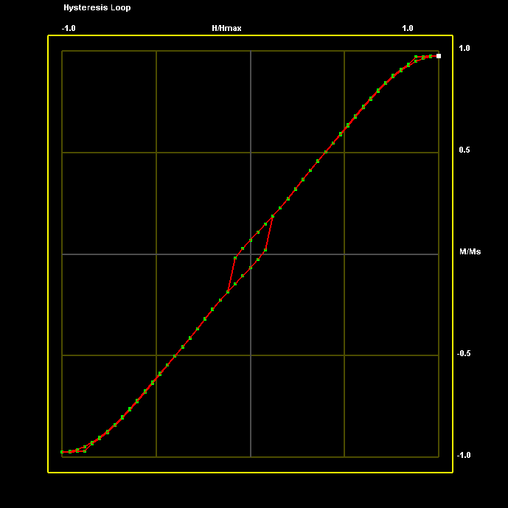
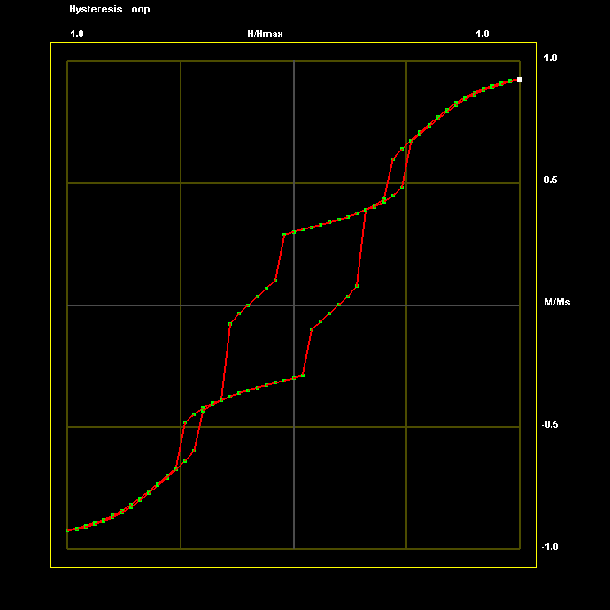
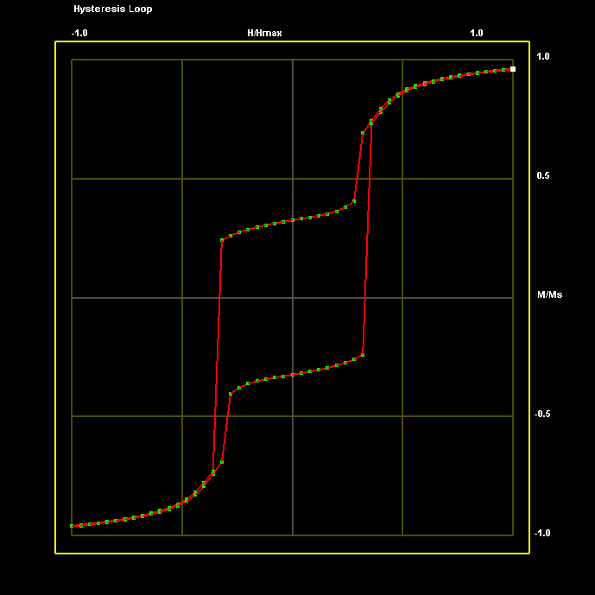
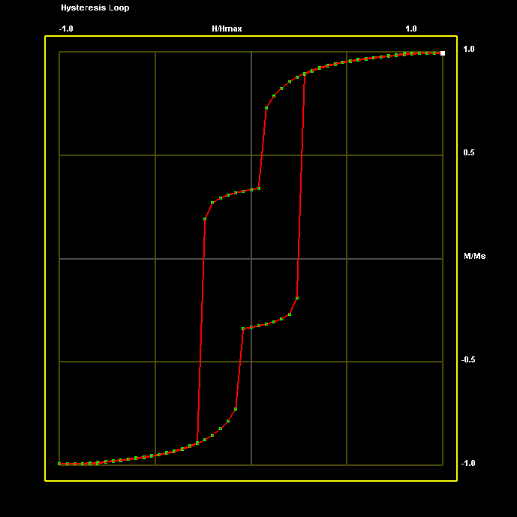
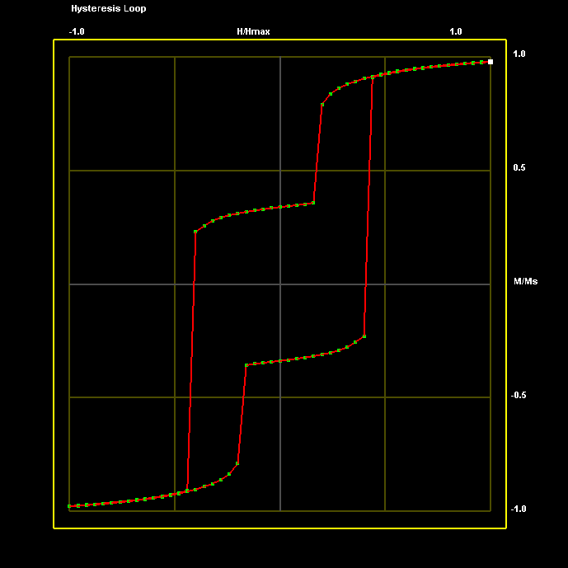
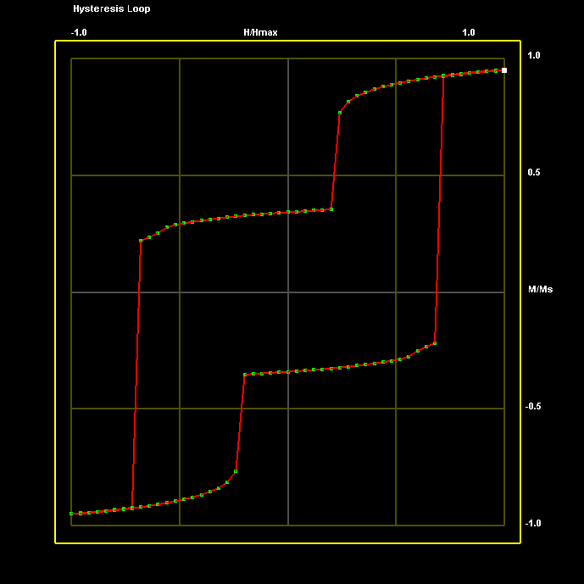
Rectangular MTJ (Ni₈₀Fe₂₀/Al₂O₃/Fe) Cells of Varying Aspect Ratio: H applied along X-Axis
50x100x10nm 4000 Oe
100x100x10nm 3000 Oe
150x100x10nm 2000 Oe
200x100x10nm 2000 Oe
225x100x10nm 2000 Oe
250x100x10nm 1250 Oe

Slide 3
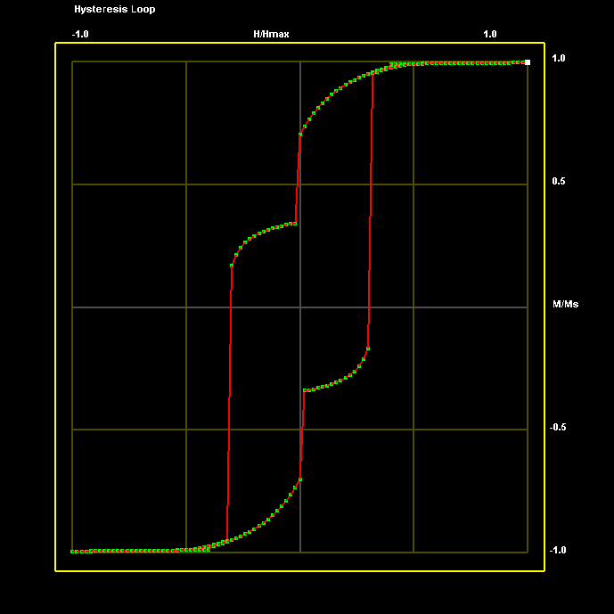
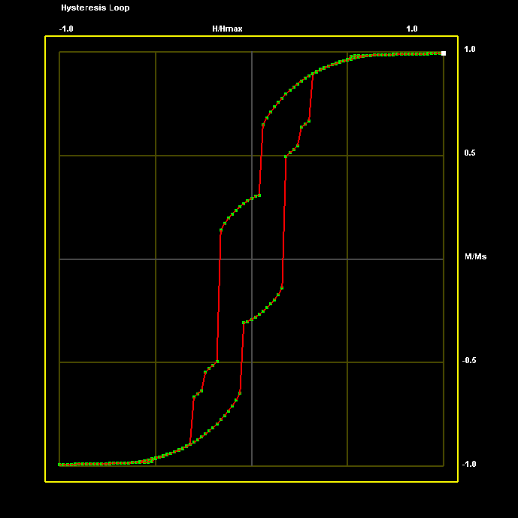
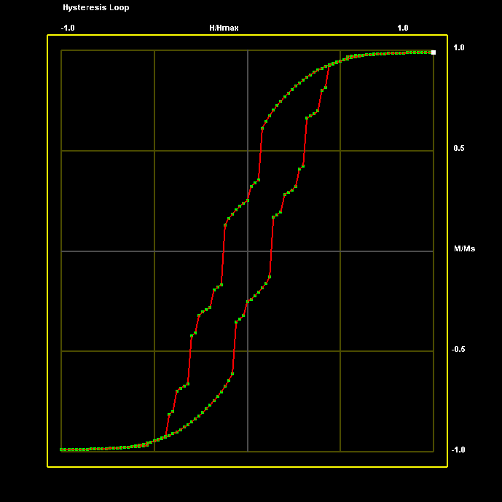
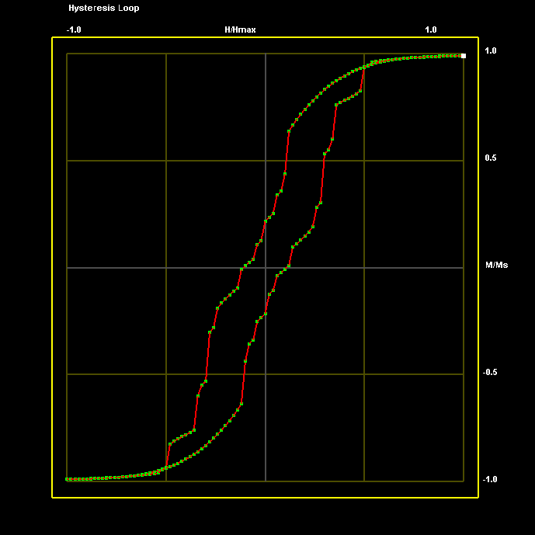

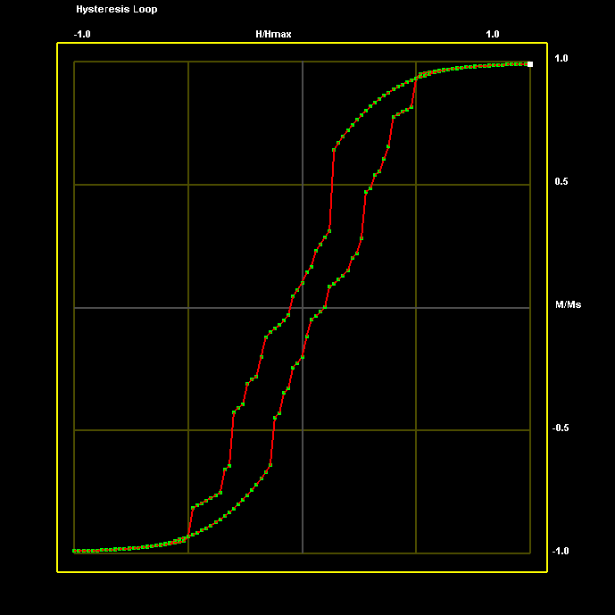
Recangular MTJ (Ni₈₀Fe₂₀/Al₂O₃/Fe) Cells of Varying Aspect Ratio: H applied along Y-Axis
50x100x10nm 5000 Oe
100x100x10nm 5000 Oe
150x100x10nm 5000 Oe
200x100x10nm 5000 Oe
225x100x10nm 5000 Oe
250x100x10nm 5000 Oe

Slide 4
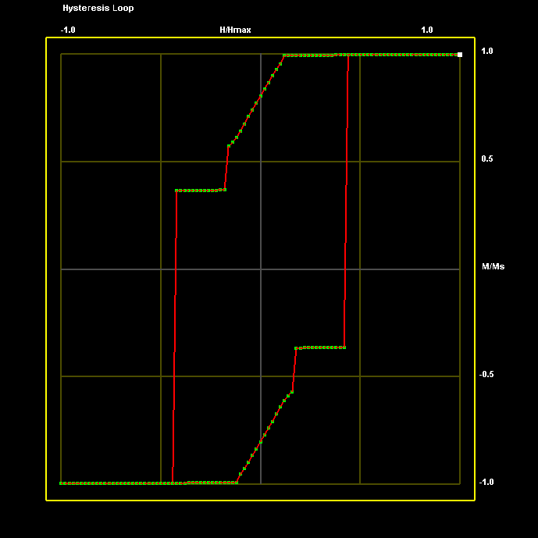
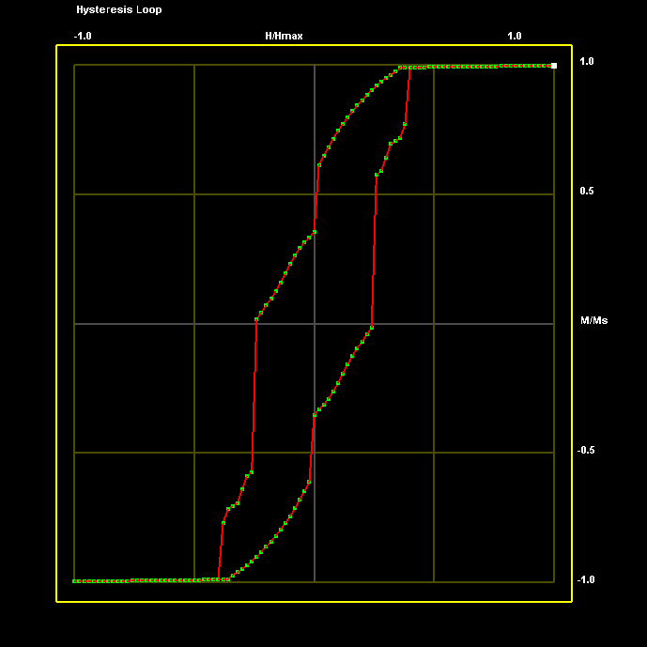
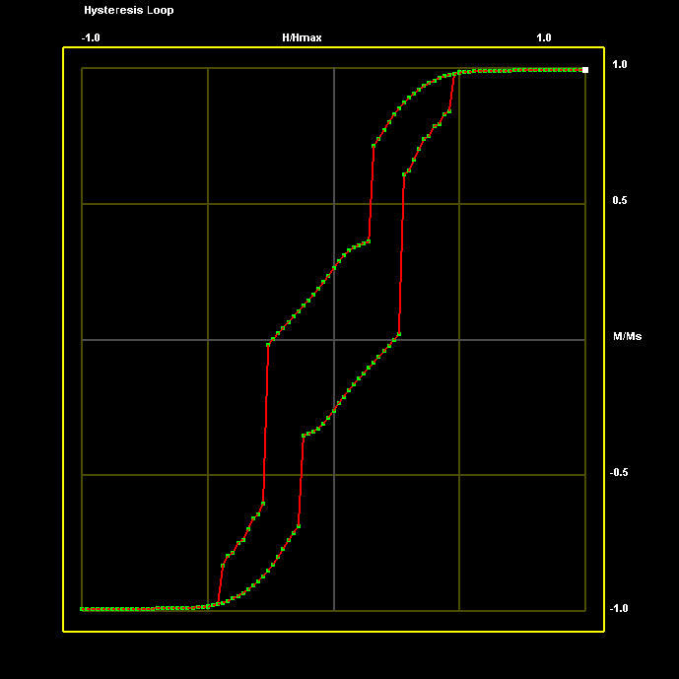
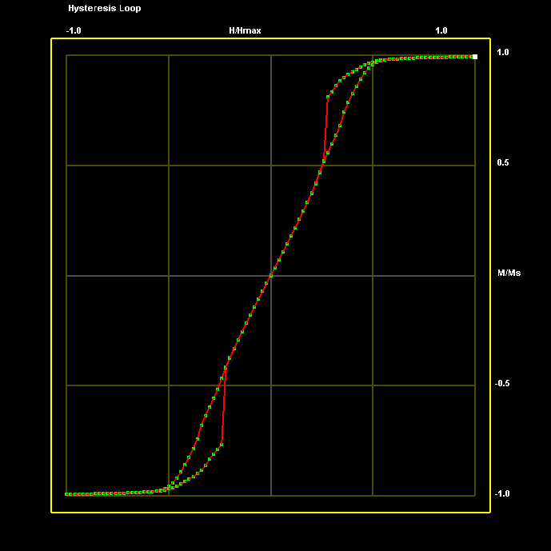
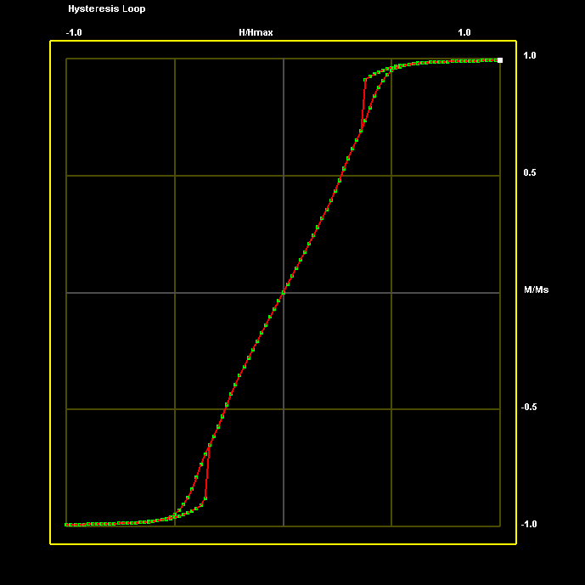
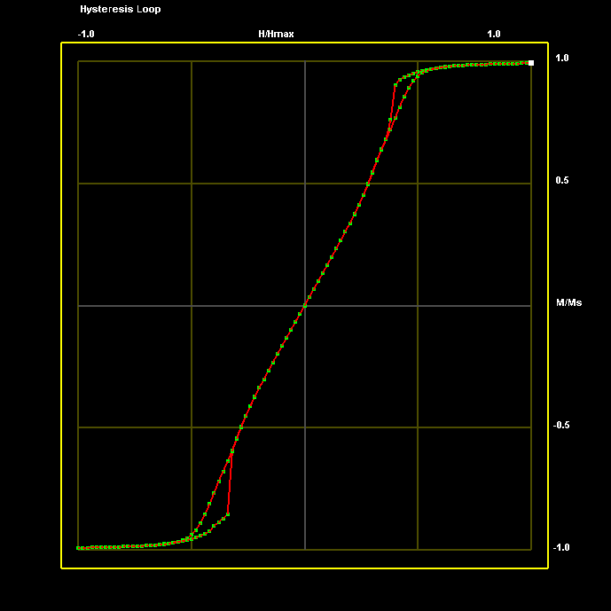
Elliptical MTJ (Ni₈₀Fe₂₀/Al₂O₃/Fe) Cells of Varying Aspect Ratio: H applied along Y-Axis
50x100x10nm 5000 Oe
100x100x10nm 5000 Oe
150x100x10nm 5000 Oe
200x100x10nm 5000 Oe
225x100x10nm 5000 Oe
250x100x10nm 5000 Oe

Slide 5
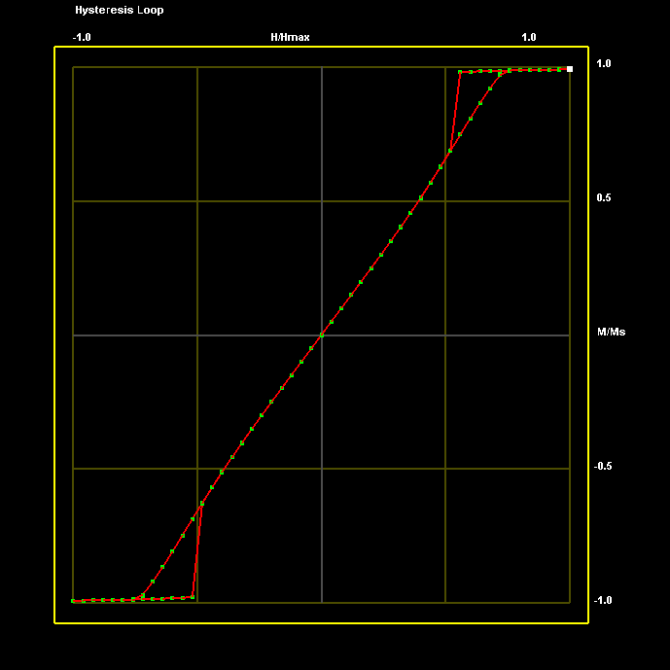
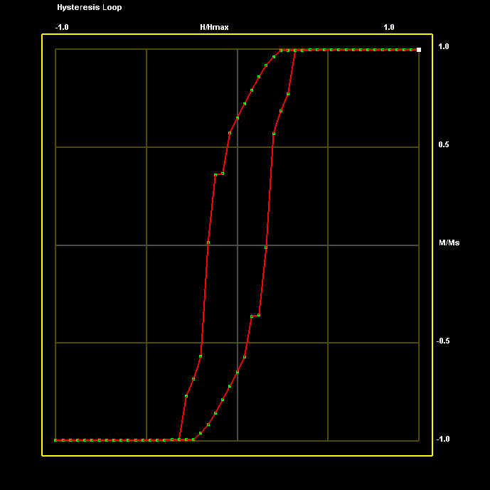
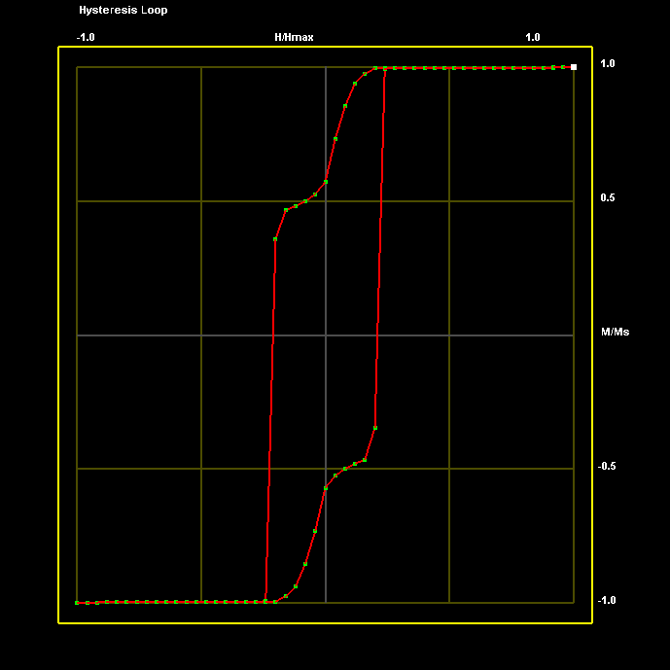
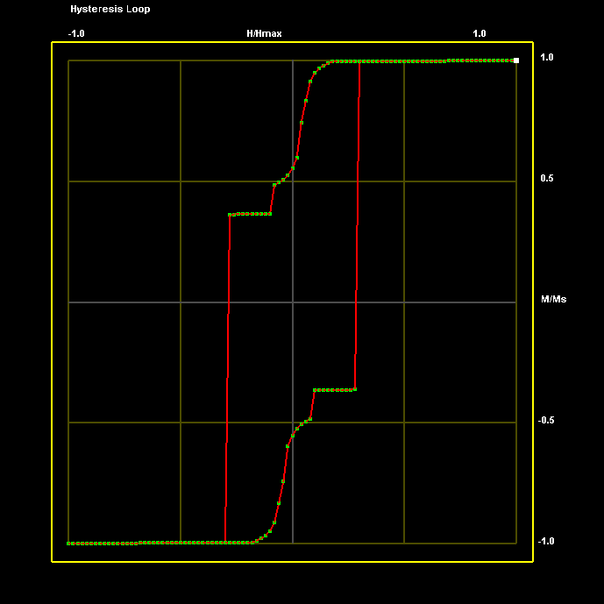
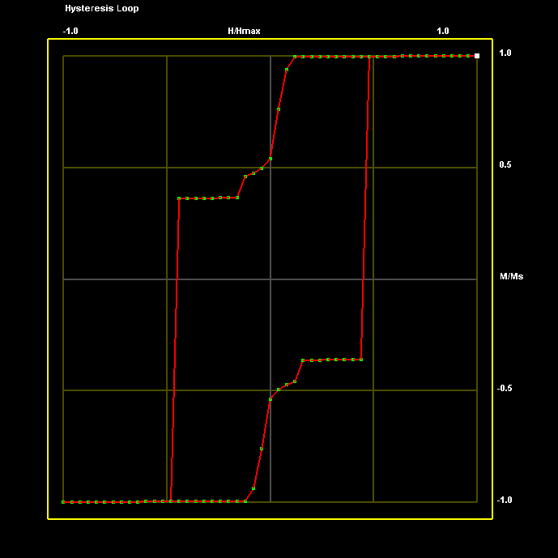
Elliptical MTJ (Ni₈₀Fe₂₀/Al₂O₃/Fe) Cells of Varying Aspect Ratio: H applied along X-Axis
50x100x10nm 5000 Oe
100x100x10nm 4000 Oe
150x100x10nm 4000 Oe
200x100x10nm 5000 Oe
225x100x10nm 5000 Oe
250x100x10nm 5000 Oe

Slide 6
GMR and Magnetic Switching of Nanoscale Spin valve Cells

Slide 7
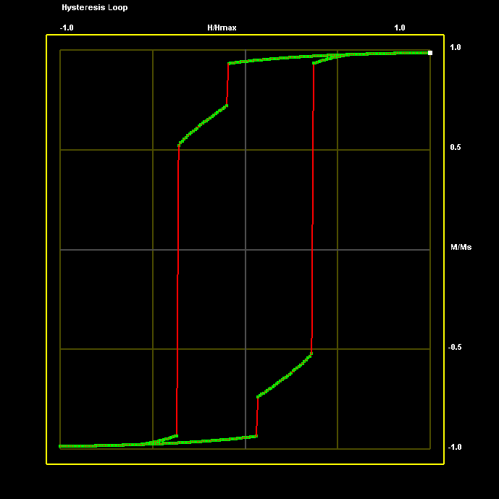
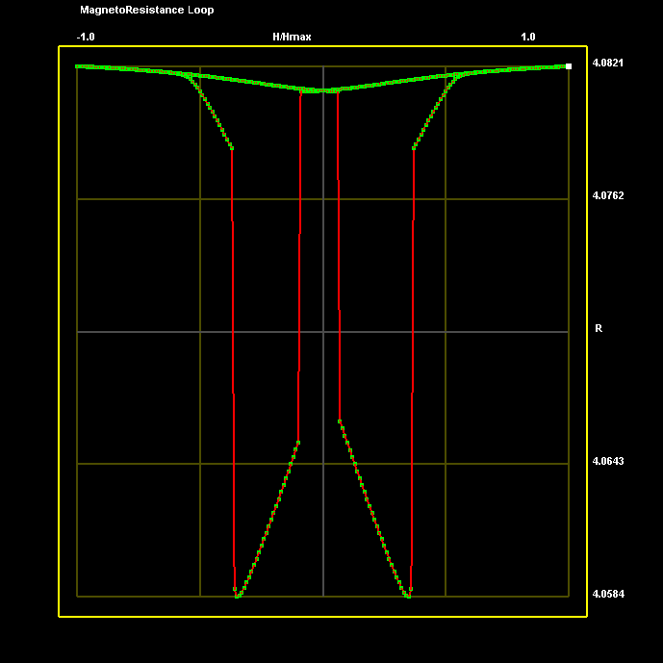
Rectangular Spin Valve (Ni₈₀Fe₂₀/Cu/ Ni₈₀Fe₂₀) Cells of Varying Aspect Ratio: H applied along X-Axis
Lateral dimensions: 100 nm x 100 nm
A_{ij}= 0, Current = 1 mA
Magnetic Field = ±1500 Oe
NiFe (10 nm)
Cu (5 nm)
NiFe (10 nm)
M
R (H)
H (Oe)
H (Oe)

Slide 8
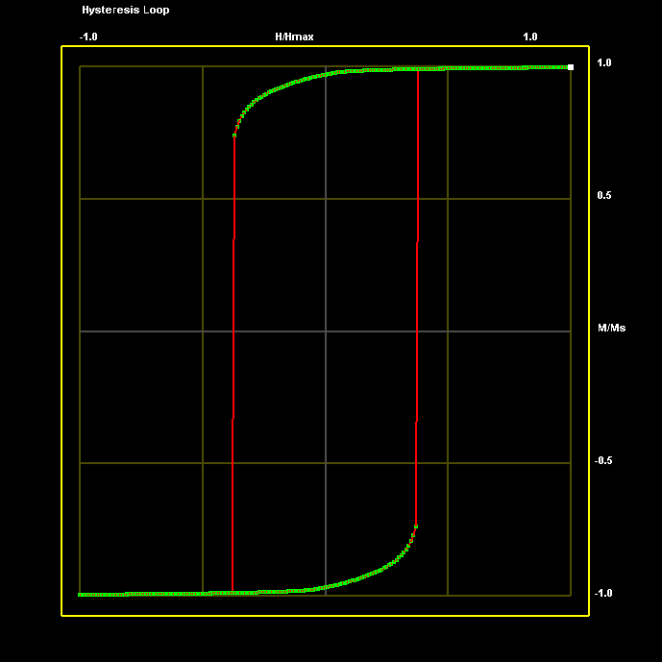
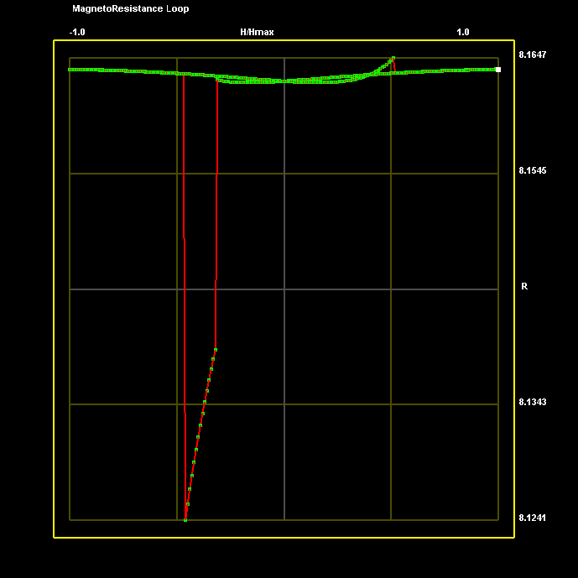
Rectangular Spin Valve (Ni₈₀Fe₂₀/Cu/ Ni₈₀Fe₂₀) Cells of Varying Aspect Ratio: H applied along X-Axis
Lateral dimensions: 200 nm x 100 nm
A_{ij}= 0, Current = 1 mA
Magnetic Field = ±1500 Oe
NiFe (10 nm)
Cu (5 nm)
NiFe (10 nm)
M
R (H)
H (Oe)
H (Oe)

Slide 9

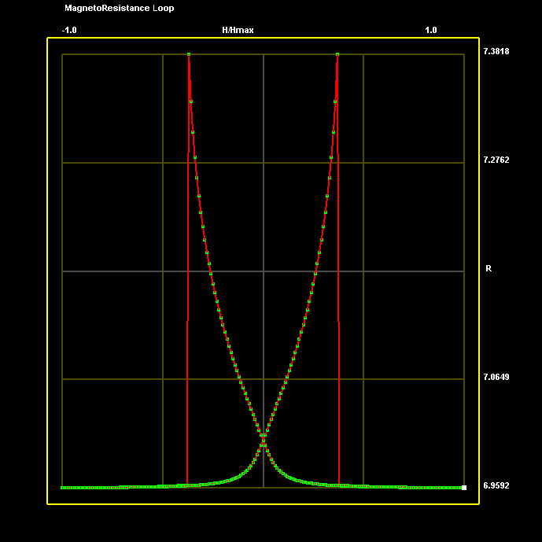
Rectangular Spin Valve (Ni₈₀Fe₂₀/Cu/ Ni₈₀Fe₂₀) Cells of Varying Aspect Ratio: H applied along X-Axis
Lateral dimensions: 250 nm x 100 nm
A_{ij}= 0, Current = 1 mA
Magnetic Field = ±1500 Oe
NiFe (10nm)
Cu (10nm)
NiFe (10nm)
M
R (H)
H (Oe)
H (Oe)

Slide 10
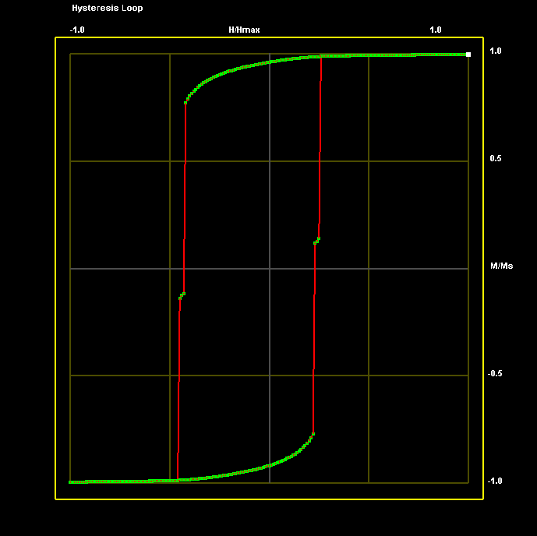
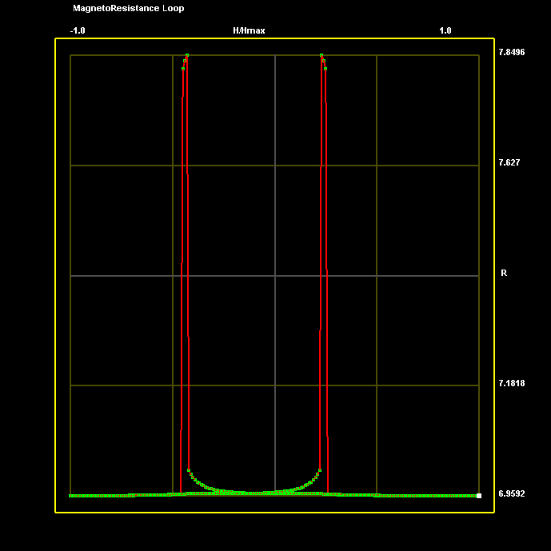
Rectangular Spin Valve (Ni₈₀Fe₂₀/Cu/ Ni₈₀Fe₂₀) Cells of Varying Aspect Ratio: H applied along X-Axis
Lateral dimensions: 250 nm x 100 nm
A_{ij}= 0, Current = 1 mA
Magnetic Field = ±1500 Oe, Pinning Field: 300 Oe
NiFe (10nm)
Cu (10nm)
NiFe (10nm)
M
R (H)
H (Oe)
H (Oe)

Slide 11
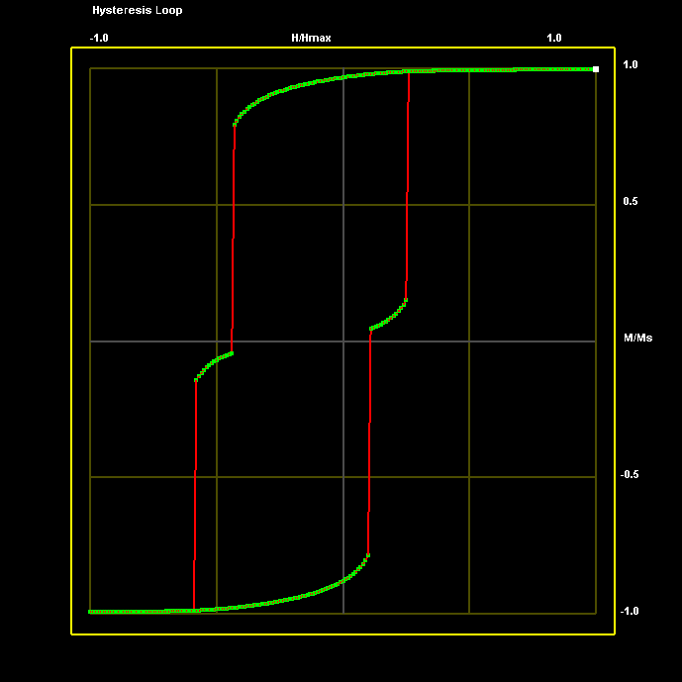
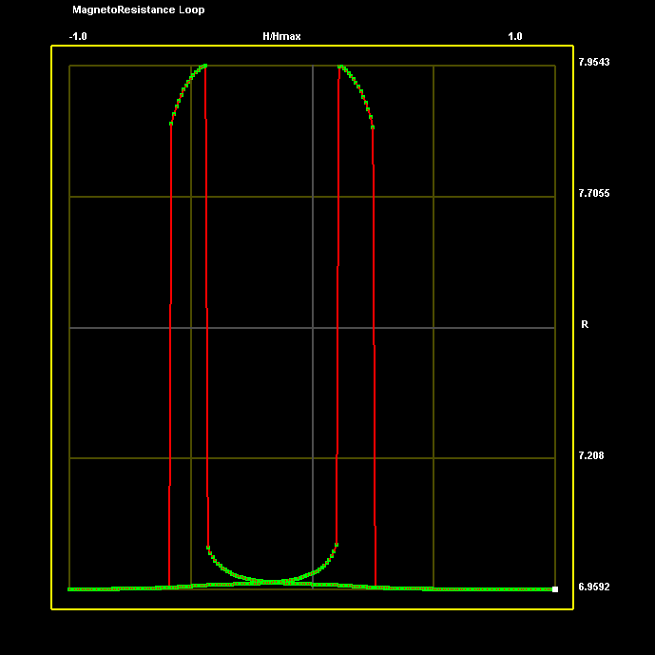
Rectangular Spin Valve (Ni₈₀Fe₂₀/Cu/ Ni₈₀Fe₂₀) Cells of Varying Aspect Ratio: H applied along X-Axis
Lateral dimensions: 250 nm x 100 nm
A_{ij}= 0, Current = 1 mA
Magnetic Field = ±1500 Oe, Pinning Field: 500 Oe
NiFe (10nm)
Cu (10nm)
NiFe (10nm)
M
R (H)
H (Oe)
H (Oe)

Slide 12
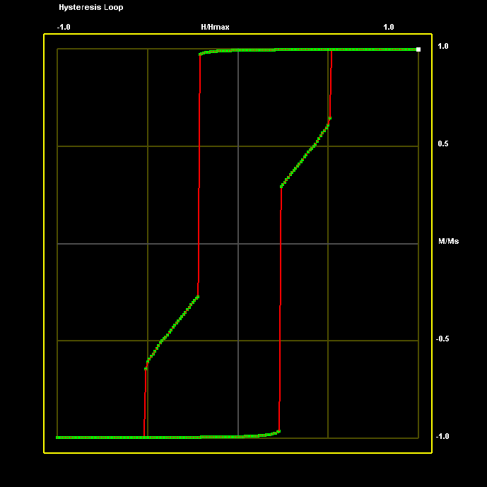
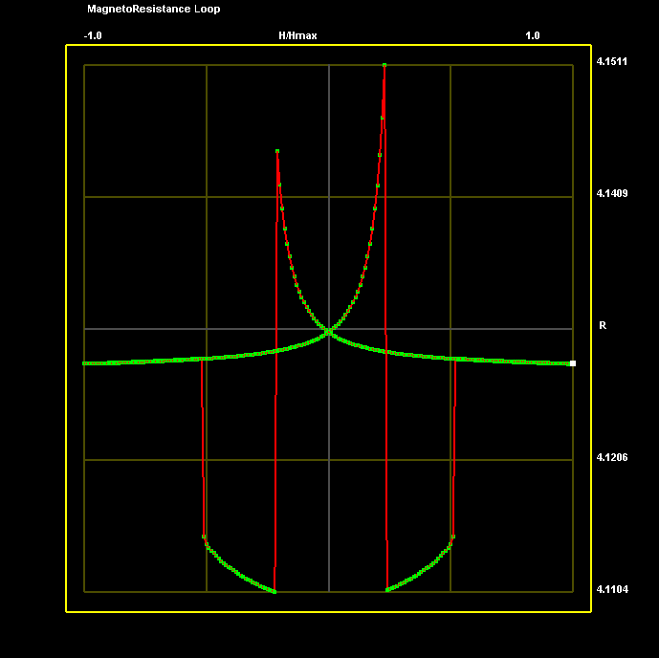
Elliptical Spin Valve (Ni₈₀Fe₂₀/Cu/ Ni₈₀Fe₂₀) Cells of Varying Aspect Ratio: H applied along X-Axis
NiFe (10nm)
Lateral dimensions: 100 nm x 100 nm
A_{ij}= 0, Current = 1 mA
Magnetic Field = ±1500 Oe
Cu (5nm)
NiFe (10nm)
M
R (H)
H (Oe)
H (Oe)

Slide 13
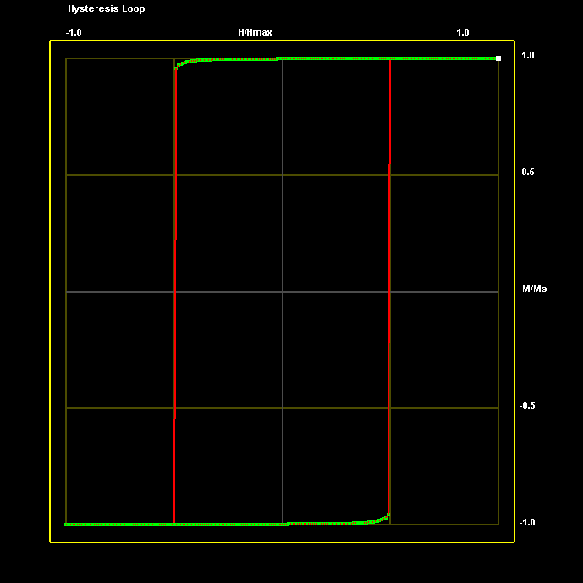
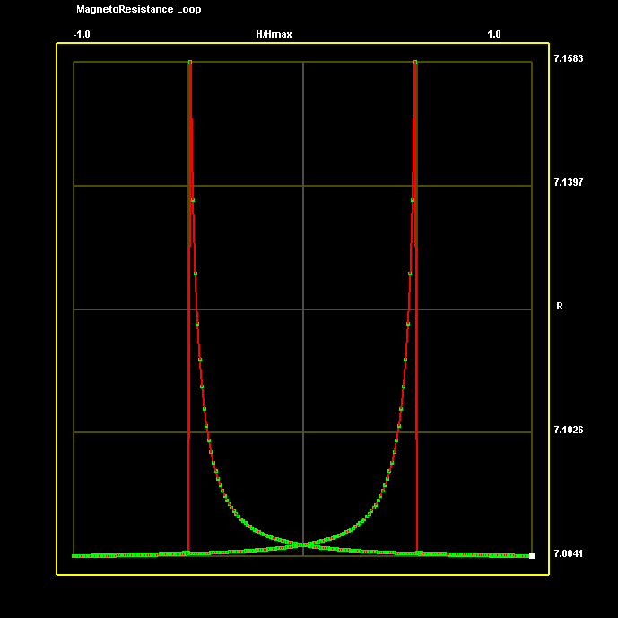
Elliptical Spin Valve (Ni₈₀Fe₂₀/Cu/ Ni₈₀Fe₂₀) Cells of Varying Aspect Ratio: H applied along X-Axis
NiFe (10nm)
Lateral dimensions: 250 nm x 100 nm
A_{ij}= 0, Current = 1 mA
Magnetic Field = ±1500 Oe
Cu (5nm)
NiFe (10nm)
M
R (H)
H (Oe)
H (Oe)

Slide 14
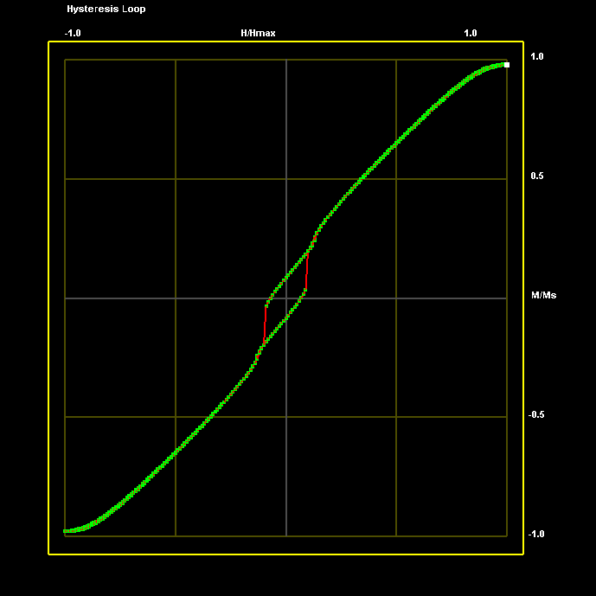
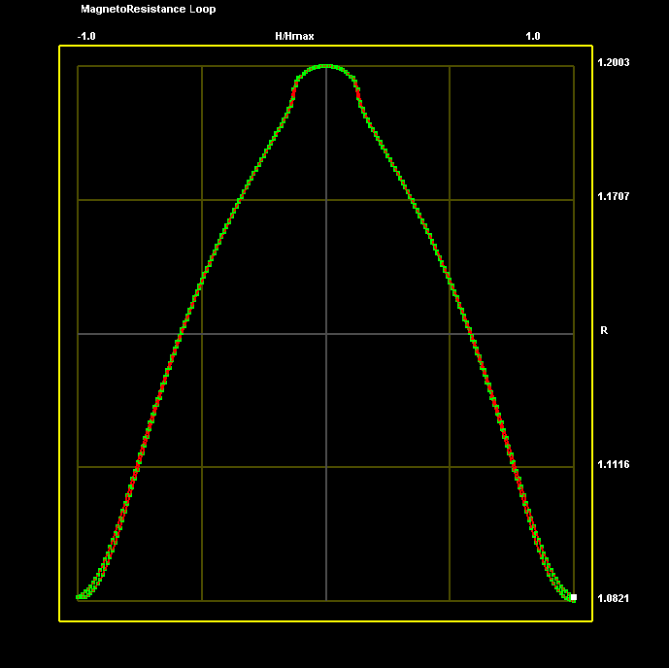
Rectangular Spin Valve (Co/Cu/ Ni₈₀Fe₂₀) Cells of Varying Aspect Ratio: H applied along X-Axis
Lateral dimensions: 50 nm x 100 nm
A_{ij}= 0, Current = 1 mA, Co Anisotropy = 400000 erg/cm³
Magnetic Field = ±2500 Oe
Co (10nm)
Cu (10nm)
NiFe (10nm)
M
R (H)
H (Oe)
H (Oe)

Slide 15
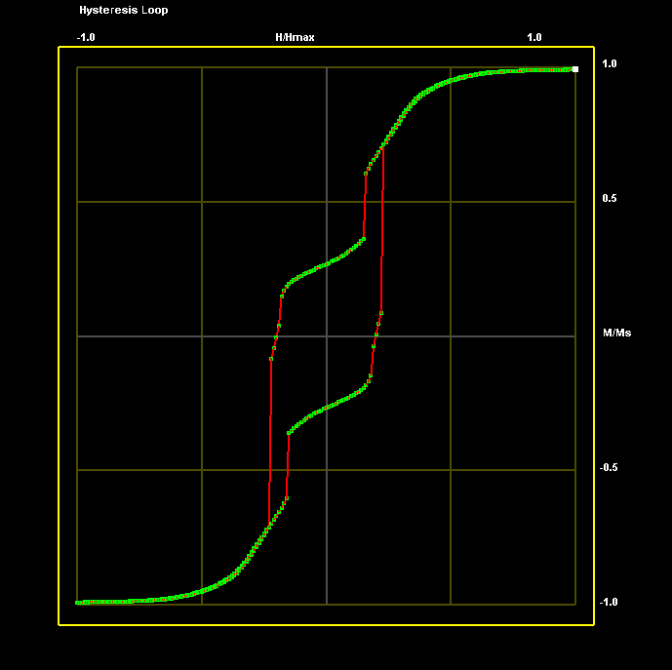
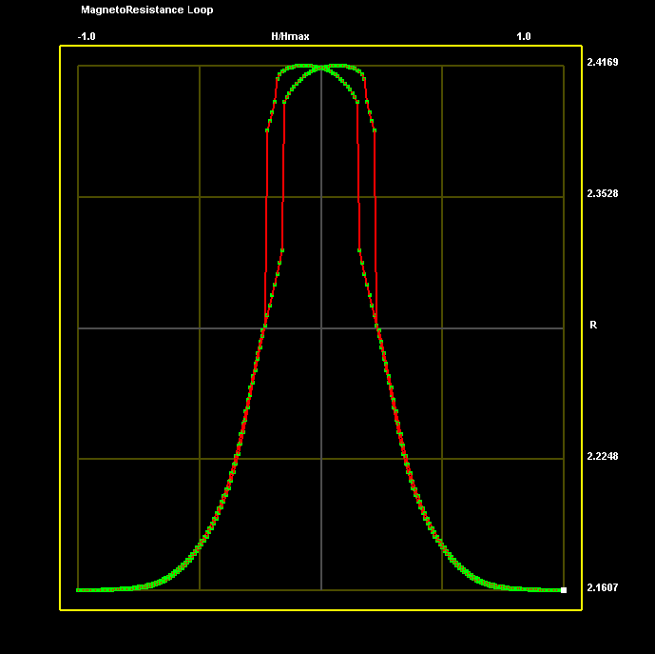
Rectangular Spin Valve (Co/Cu/ Ni₈₀Fe₂₀) Cells of Varying Aspect Ratio: H applied along X-Axis
Lateral dimensions: 100 nm x 100 nm
A_{ij}= 0, Current = 1 mA, Co Anisotropy = 400000 erg/cm³
Magnetic Field = ±2500 Oe
Co (10nm)
Cu (10nm)
NiFe (10nm)
M
R (H)
H (Oe)
H (Oe)

Slide 16
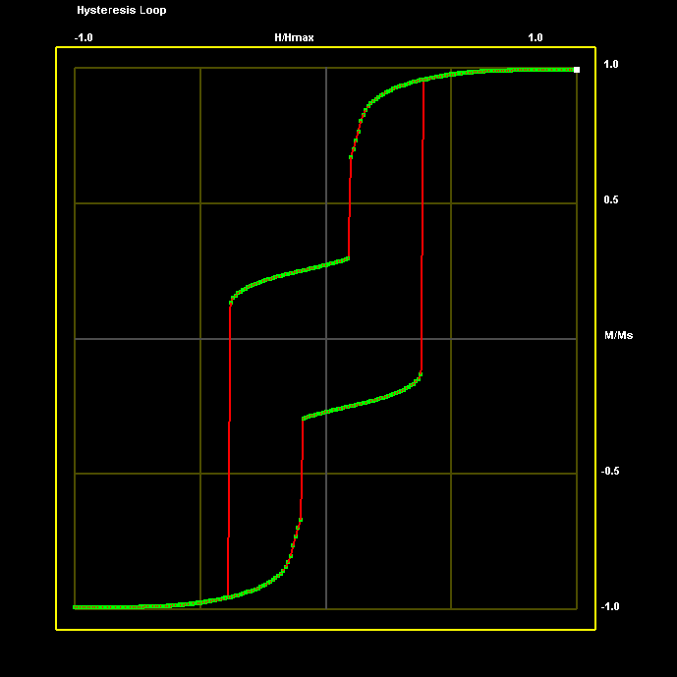
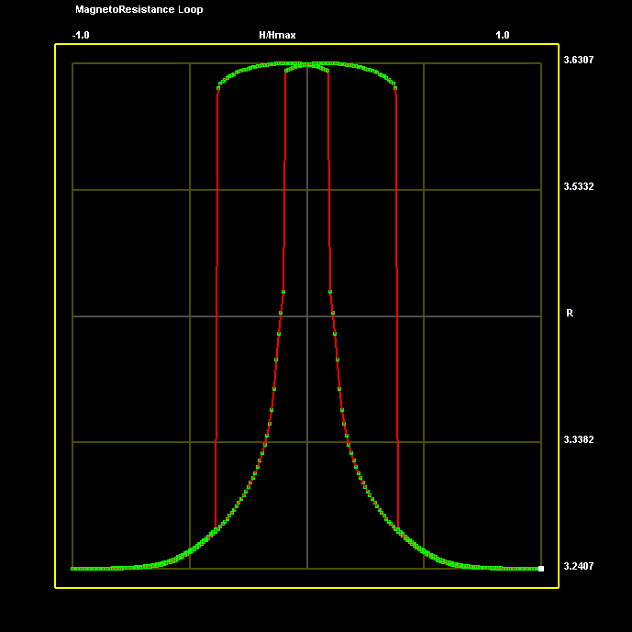
Rectangular Spin Valve (Co/Cu/ Ni₈₀Fe₂₀) Cells of Varying Aspect Ratio: H applied along X-Axis
Lateral dimensions: 150 nm x 100 nm
A_{ij}= 0, Current = 1 mA, Co Anisotropy = 400000 erg/cm³
Magnetic Field = ±2500 Oe
Co (10nm)
Cu (10nm)
NiFe (10nm)
M
R (H)
H (Oe)
H (Oe)

Slide 17
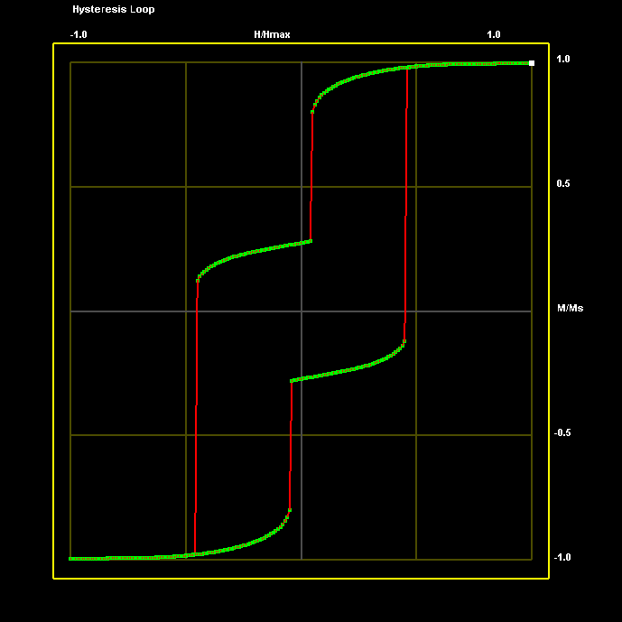
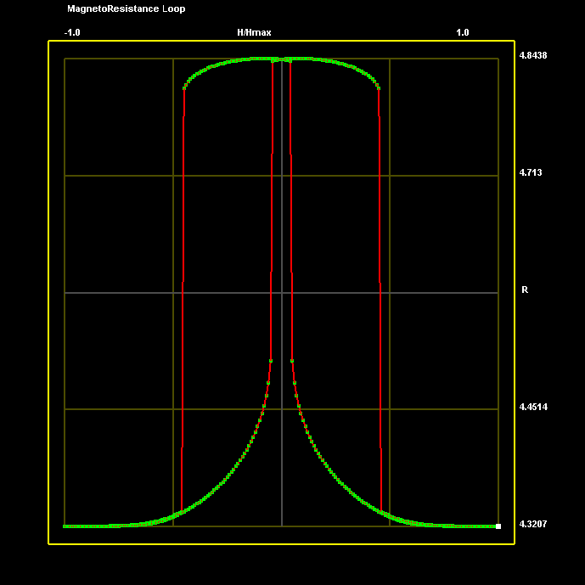
Rectangular Spin Valve (Co/Cu/ Ni₈₀Fe₂₀) Cells of Varying Aspect Ratio: H applied along X-Axis
Lateral dimensions: 200 nm x 100 nm
A_{ij}= 0, Current = 1 mA, Co Anisotropy = 400000 erg/cm³
Magnetic Field = ±2500 Oe
Co (10nm)
Cu (10nm)
NiFe (10nm)
M
R (H)
H (Oe)
H (Oe)

Slide 18
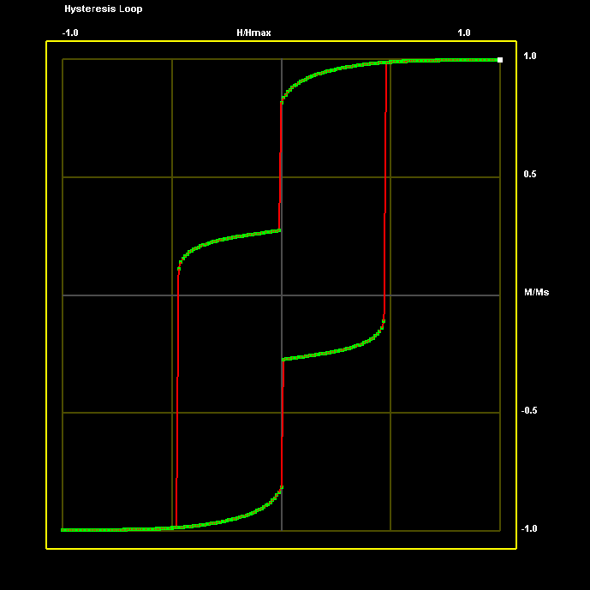
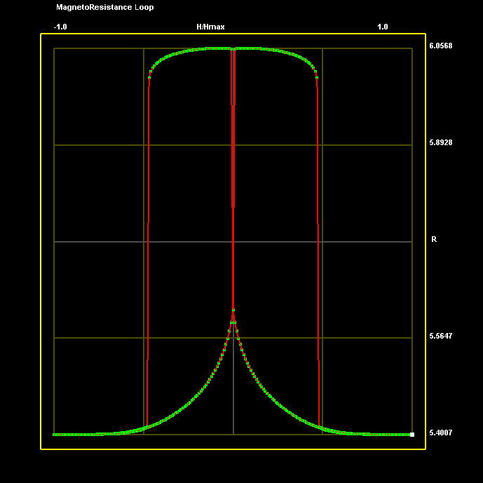
Rectangular Spin Valve (Co/Cu/ Ni₈₀Fe₂₀) Cells of Varying Aspect Ratio: H applied along X-Axis
Lateral dimensions: 250 nm x 100 nm
A_{ij}= 0, Current = 1 mA, Co Anisotropy = 400000 erg/cm³
Magnetic Field = ±2500 Oe
Co (10nm)
Cu (10nm)
NiFe (10nm)
M
R (H)
H (Oe)
H (Oe)

Slide 19
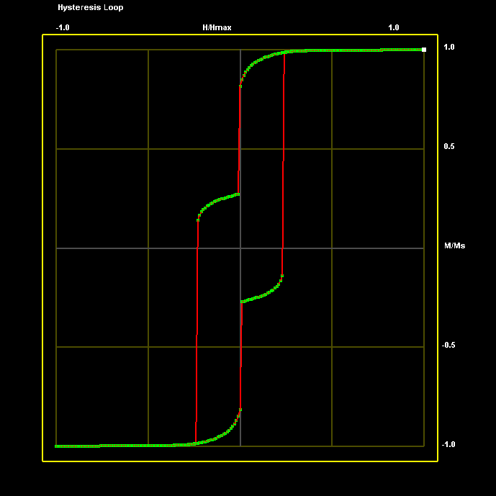
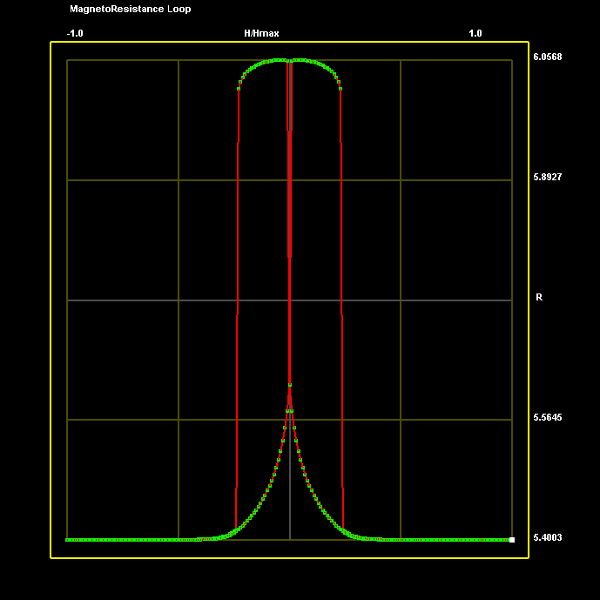
Rectangular Spin Valve (Co/Cu/ Ni₈₀Fe₂₀) Cells of Varying Aspect Ratio: H applied along X-Axis
Lateral dimensions: 250 nm x 100 nm
A_{ij}= 0, Current = 1 mA, Co Anisotropy = 400000 erg/cm³
Magnetic Field = ±5000 Oe
Co (10nm)
Cu (10nm)
NiFe (10nm)
M
MR
H (Oe)
H (Oe)

Slide 20

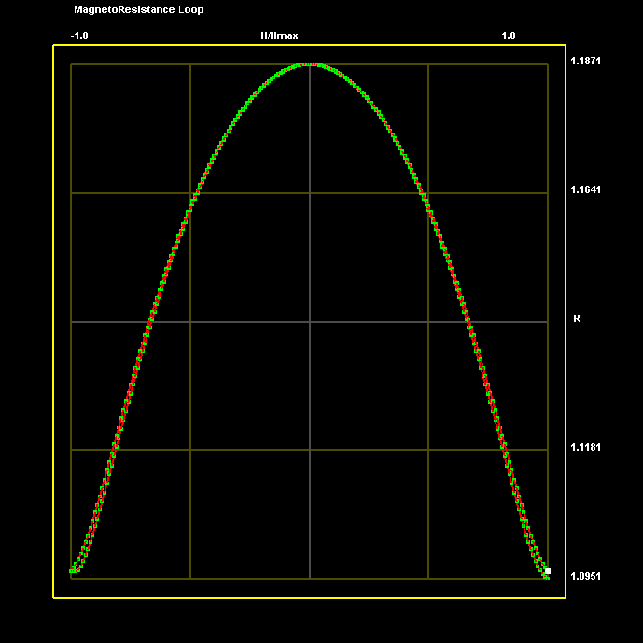
Elliptical Spin Valve (Co/Cu/ Ni₈₀Fe₂₀) Cells of Varying Aspect Ratio: H applied along X-Axis
Lateral dimensions: 50 nm x 100 nm
A_{ij}= 0, Current = 1 mA, Co Anisotropy = 400000 erg/cm³
Magnetic Field = ±2500 Oe
Co (10nm)
Cu (10nm)
NiFe (10nm)
M
MR
H (Oe)
H (Oe)

Slide 21
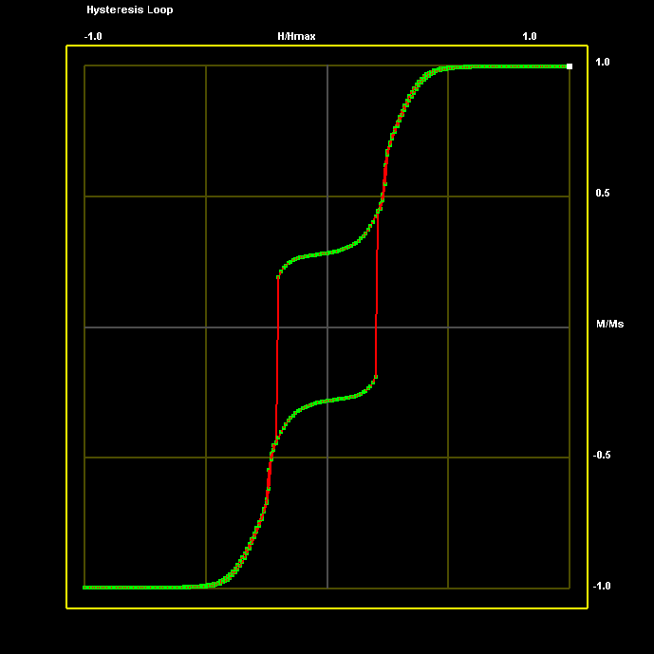
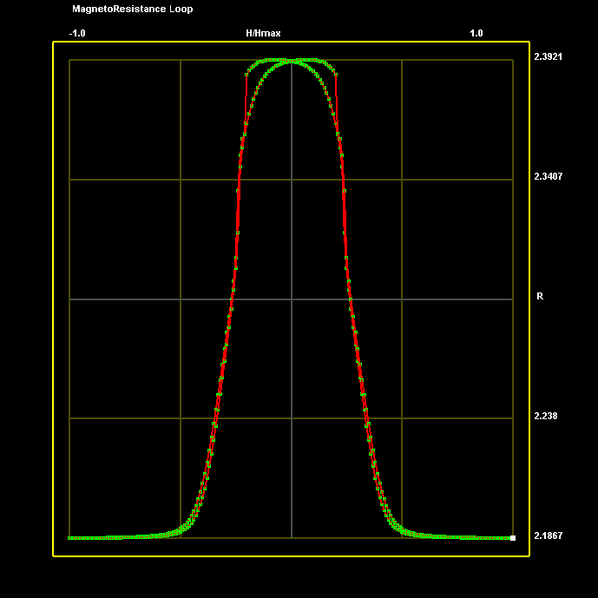
Elliptical Spin Valve (Co/Cu/ Ni₈₀Fe₂₀) Cells of Varying Aspect Ratio: H applied along X-Axis
Co (10nm)
Lateral dimensions: 100 nm x 100 nm
A_{ij}= 0, Current = 1 mA, Co Anisotropy = 400000 erg/cm³
Magnetic Field = ±2500 Oe
Cu (10nm)
NiFe (10nm)
M
R (H)
H (Oe)
H (Oe)

Slide 22


Elliptical Spin Valve (Co/Cu/ Ni₈₀Fe₂₀) Cells of Varying Aspect Ratio: H applied along X-Axis
Lateral dimensions: 150 nm x 100 nm
A_{ij}= 0, Current = 1 mA, Co Anisotropy = 400000 erg/cm³
Magnetic Field = ±2500 Oe
Co (10nm)
Cu (10nm)
NiFe (10nm)
M
R (H)
H (Oe)
H (Oe)

Slide 23


Elliptical Spin Valve (Co/Cu/ Ni₈₀Fe₂₀) Cells of Varying Aspect Ratio: H applied along X-Axis
Lateral dimensions: 200 nm x 100 nm
A_{ij}= 0, Current = 1 mA, Co Anisotropy = 400000 erg/cm³
Magnetic Field = ±2500 Oe
Co (10nm)
Cu (10nm)
NiFe (10nm)
M
R (H)
H (Oe)
H (Oe)

Slide 24


Elliptical Spin Valve (Co/Cu/ Ni₈₀Fe₂₀) Cells of Varying Aspect Ratio: H applied along X-Axis
Lateral dimensions: 250 nm x 100 nm
A_{ij}= 0, Current = 1 mA, Co Anisotropy = 400000 erg/cm³
Magnetic Field = ±2500 Oe
Co (10nm)
Cu (10nm)
NiFe (10nm)
R (H)
M
H (Oe)
H (Oe)

Slide 25


Elliptical Spin Valve (Co/Cu/ Ni₈₀Fe₂₀) Cells of Varying Aspect Ratio: H applied along X-Axis
Lateral dimensions: 125 nm x 100 nm
A_{ij}= 0, Current = 1 mA, Co Anisotropy = 400000 erg/cm³
Magnetic Field = ±2500 Oe
Co (10nm)
Cu (10nm)
NiFe (10nm)
M
R (H)
H (Oe)
H (Oe)

Slide 26






Comparison between single and arrays of spin valve cells
Lateral dimensions: 125 nm x 100 nm; A_{ij}= 0, Current = 1 mA, Co Anisotropy = 400000 erg/cm³
Magnetic Field = ±2500 Oe
Single
2 x 2
(s = 10 nm)
2 x 2
(s = 25 nm)
2 x 2
(s = 50 nm)
M
M
M
M
R (H)
R (H)
R (H)
R (H)
H (Oe)
H (Oe)
H (Oe)
H (Oe)

